Slide 1
Problem Statement 2 – DVWA Deployment & Attack Demonstration
Kubernetes (Minikube)
AccuKnox – Solution Engineer Trainee Assignment

Slide 2
Objective
Deploy DVWA on Kubernetes using Minikube
Demonstrate common web application attack vectors
Understand security risks in containerized workloads

Slide 3
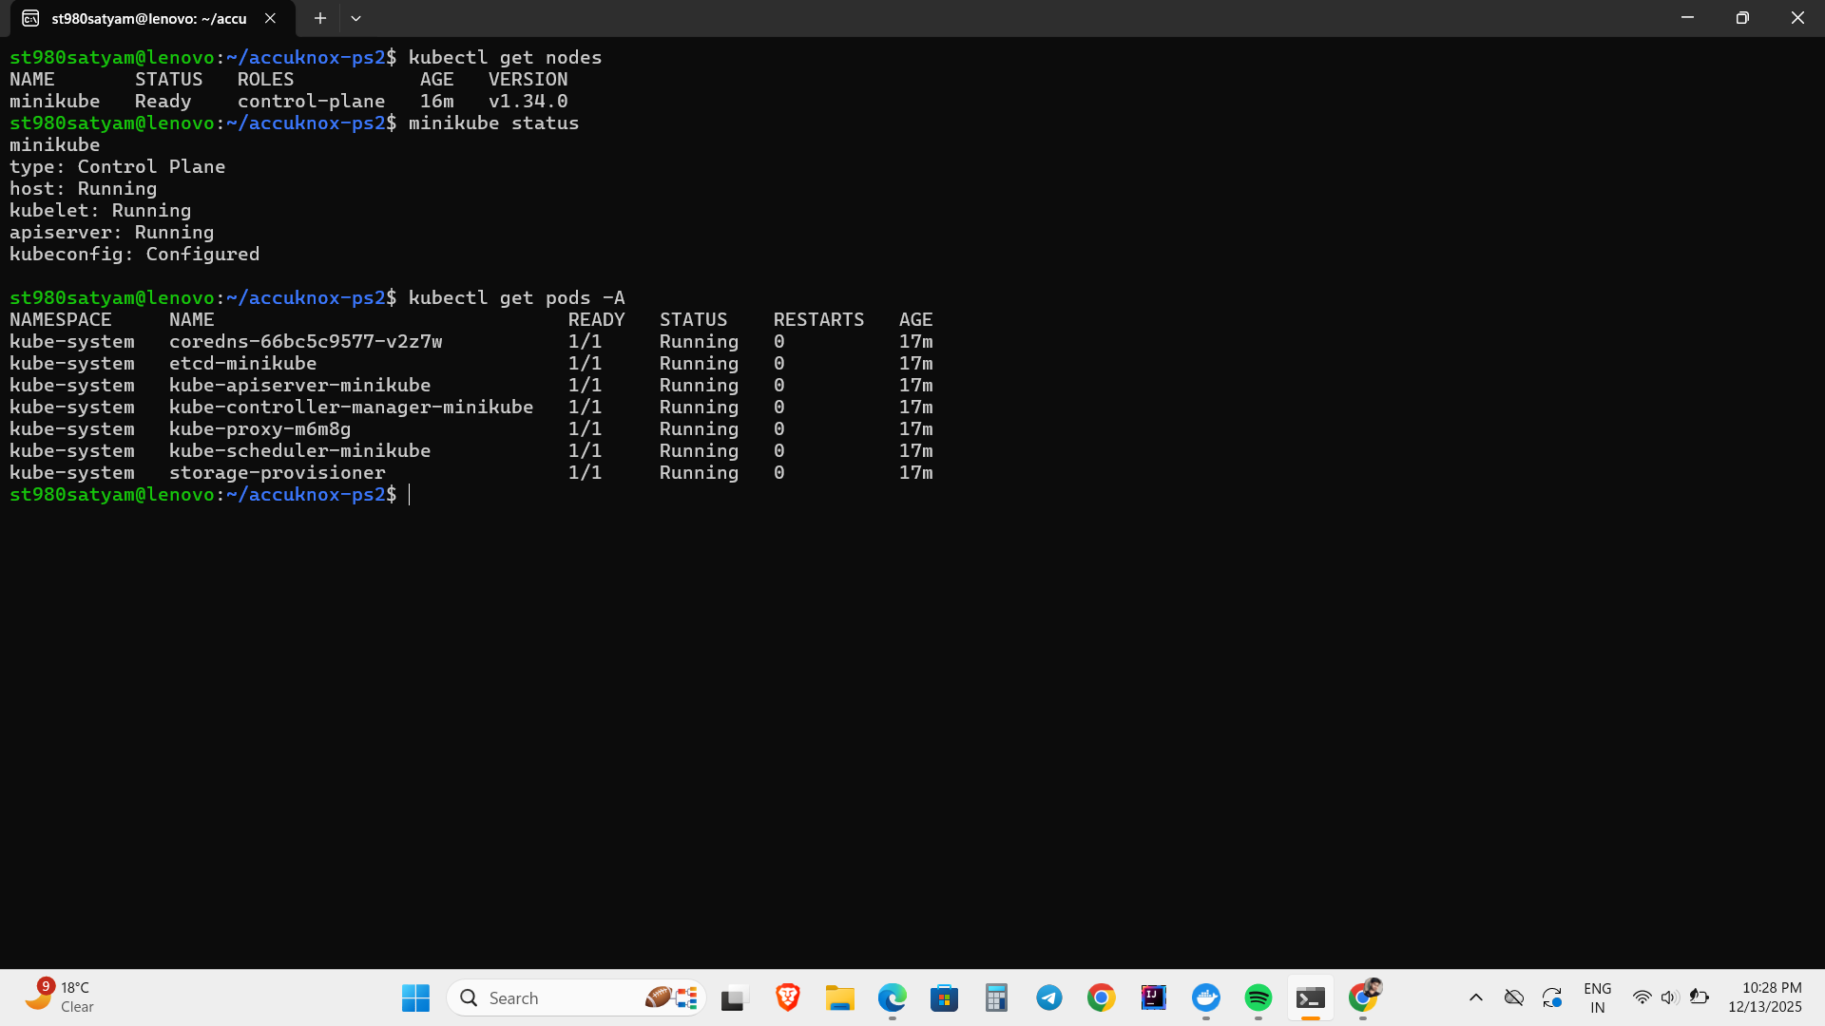
Sample Kubernetes Setup (Expected Output #1)
Local Kubernetes cluster using Minikube
DVWA deployed via Kubernetes Deployment
Highlights need for runtime security and policy enforcement
Application accessed using port-forwarding
Screenshots included to demonstrate the attack execution

Slide 4
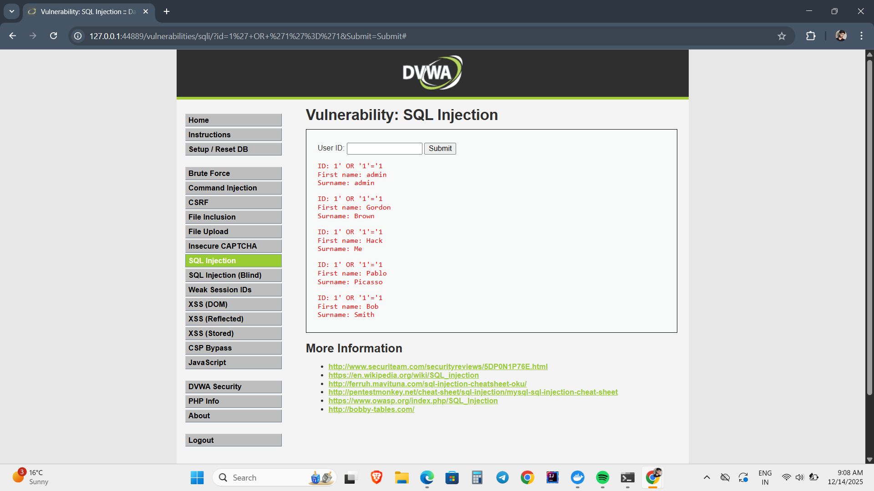
Attack Vector 1: SQL Injection
Exploited improper input validation
Unauthorized database interaction observed
Screenshots included to demonstrate the attack execution

Slide 5
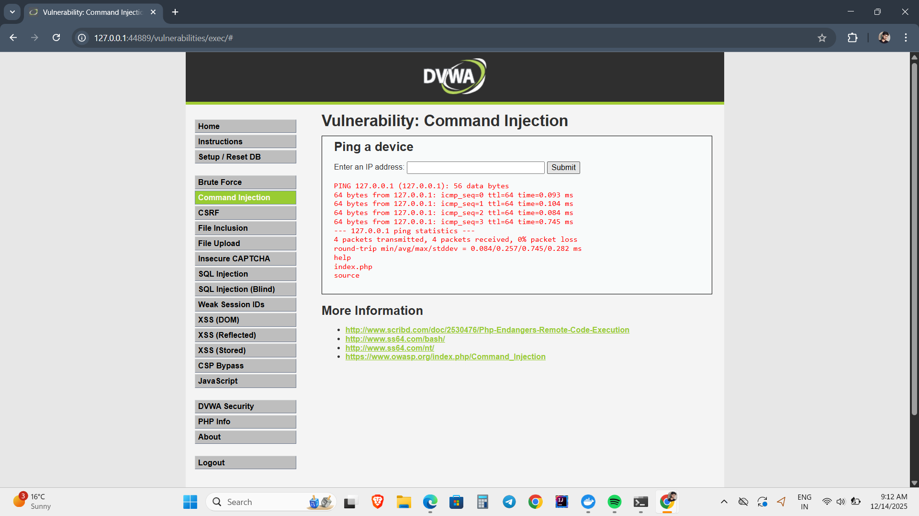
Attack Vector 2: Command Injection
OS command execution via vulnerable input
Demonstrates risk of container breakout paths
Screenshots included to demonstrate the attack execution

Slide 6
Attack Vector 3: XSS
JavaScript injection via input fields
Highlights client-side exploitation risks
Screenshots included to demonstrate the attack execution

Slide 7
Conclusion (Expected Output #2)
Demonstrated real-world attack surfaces
Highlights need for runtime security controls
Reinforces importance of Kubernetes workload protection

Slide 8
References & Project Artifacts
GitHub Repository:
https://github.com/satyamtiwari06/AccoKnox-Assignment/tree/main/problem-statement-2
Includes:
Kubernetes manifests
Attack demonstration screenshots

